Slide 1

24 month STEM OPT extension
Deborah Pabon
Senior international student advisor

Slide 2
DISCLAIMER
The Office of International Affairs (OIA) is able to provide general guidance. Any advice provided by OIA, including the information in this presentation, should not be construed as legal advice.
Due to the fluid nature of governmental interpretation, DHS, USCIS, SEVP and other governmental agencies may change their interpretations of these immigration laws/regulations and eligibility requirements for benefits, at any time. OIA is committed to providing advice based on the most current guidance.
Each case is fact specific, and it is advised that students contact an experienced immigration attorney with questions regarding individual situations.

Slide 3
AGENDA
STEM OPT Eligibility
Important Dates to Remember
Application Process
​Institution Accreditation
After submission/Pending STEM OPT Application
STEM OPT Approved
Reporting Employment
Reporting Requirements

Slide 4
Who is eligible for STEM OPT
Students who have already been approved for 12 months of post-completion OPT; and
Students who have earned a bachelor’s or higher degree in a field included on the U.S. Government’s list of Science, Technology, Engineering, and Mathematics (STEM) fields within the last 10 years; and
Students who are employed in a paid job directly related to their field of study; and
Students who are working for an employer that is enrolled in the U.S. Government’s E-Verify program (https://www.e-verify.gov/employers). Purpose of E-Verify is to confirm employment eligibility to the Government.
Please Note:
All four of the above criteria must be met for a student to be eligible for the 24-month OPT extension.
If you do not meet with the above requirements, you are NOT ELIGIBLE for STEM OPT.

Slide 5
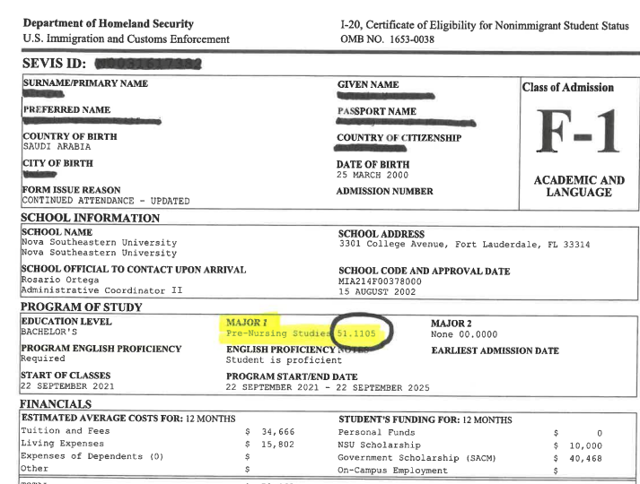

Slide 6
STEM OPT eligibility cont.
Under certain circumstances, an F-1 student may use a prior STEM degree from a currently accredited SEVP-certified school to fulfill this eligibility requirement. To use a prior degree to qualify for the STEM OPT extension, the F-1 student must:
Have received their most recent/current degree (which does not need to be STEM-related) from a currently accredited Student and Exchange Visitor Program (SEVP) certified school.
Have received their prior, qualifying STEM degree (at the bachelor's level or higher) within 10 years of applying for the STEM OPT extension with USCIS.
The qualifying STEM degree needs to be on DHS's STEM Designated Degree Program List at the time the student submits their application for the STEM OPT extension, rather than at the time that the student received the degree.
You can obtain which programs of study qualify for the STEM OPT extension in the following link: https://www.ice.gov/doclib/sevis/pdf/stemList2023.pdf
Additional information also found by visiting the Study in the States website.

Slide 7
What is the Institution Accreditation
Institution Accreditation is the evidence that the institution that granted your STEM degree is currently accredited by the U.S. Department of Education and certified by the Student Exchange and Visitor Program (SEVP) if this STEM OPT is based on a previously earned STEM degree.
If you are applying for STEM OPT extension based on your same degree as the post-completion OPT degree from NSU, you do not need to upload the document.
If your STEM OPT extension is based on an already earned STEM degree, you must upload evidence that NSU is an institution accredited by the U.S. Department of Education. This information can be found in the following link: certified-school-list-10-19-22.pdf (dhs.gov) Please upload the PDF of the accreditation.

Slide 8
Important dates to remember
Students must apply for the 24-month STEM Extension OPT up to 90 days prior to the expiration of the first 12 months of “regular” OPT.
Students may not apply for STEM OPT extensions during the 60-day grace period following an initial (usually 12-month) period of post-completion OPT.
The application is now an ONLINE process and OIA will provide you with the endorsed I-20 recommending STEM OPT. Once received apply for STEM OPT Extension through USCIS directly.
Continue employment even if your previous EAD card is expired until your OPT extension is processed or until 180 days has passed, whichever is sooner. If you apply prior to the current 12-month OPT expiration.
The maximum period of unemployment days is 150 days, which includes any days of unemployment during the initial 12 months of Post-Completion OPT.
IMPORTANT: DO NOT apply online for STEM OPT extension with USCIS until you have received the Form I-20 with the DSO recommendation. Filing without endorsed I-20 may get your application denied.

Slide 9
Application process
Visit OIA website https://www.nova.edu/internationalaffairs/index.html
Select Office of International Students and Scholars and then Employment
Search for STEM OPT and follow instructions
Visit https://myaccount.uscis.gov/ and create an account
Submit your request to OIA to obtain your endorsed I-20
OPT APPLICATION PACKET
DRAFT OF I-765 FORM
FORM I-983 https://www.ice.gov/doclib/sevis/pdf/i983.pdf
(Instructions for I-983 (https://www.ice.gov/doclib/sevis/pdf/i983Instructions.pdf)
OIA processing times are 7 to 10 BUSINESS DAYS
DO NOT apply online for STEM OPT extension with USCIS until you have received the Form I-20 with the DSO recommendation.
Filing without endorsed I-20 may get your application denied.

Slide 10
After submission
Check your USCIS online account often to see if you receive a receipt number and any updates.
Be on the lookout for an approval notice and EAD card from USCIS. It will be mailed to the mailing address listed on your Form I-765. If your mailing address changes while the process is pending, submit a Change of Address with USCIS online or by calling 800-375-5283.
Notify OIA immediately if you receive a Request for Evidence (RFE) or Request for Information (RFI). Email a copy of the documents requested to intl@nova.edu. Failure to respond to a RFE or RFI will lead to a denial of your OPT request.
If there is any problem with your EAD (name misspelled, wrong dates, etc). call USCIS at 800-375-5283
If you want to withdraw your OPT application after submission to USCIS and before it has been approved, contact OIA

Slide 11
Once you have filed your
Application and is in Pending status,
we strongly recommend
NOT
to travel
Once your STEM OPT is Approved if you are traveling you will need:
Unexpired passport
Valid visa
Updated I-20 with travel signature SIX MONTHS or less /employer information
EAD card with extension
Proof of employment
NOTE: Be aware that while OPT STEM is pending approval by USCIS, your eligibility for re-entry may be questioned by a Customs and Border Protection officer when seeking entry to the US.

Slide 12
STEM OPT Approved
At all times while you are in STEM OPT you must continue to comply with F-1 reporting requirements.
Provide OIA with copy of your STEM OPT EAD Card
You must also comply with employment reporting guidelines
Must report any changes of employment within 10 days of a change
Must report employment termination within 10 days
Must report any changes of local and/or mailing address within 10 days of a change

Slide 13
Reporting employment
You are required to make a validation report to ISSS every six months starting from the date your 24-month OPT starts. The report is due within 10 days of the required reporting date.
6 Month Reporting: Send an email to intl@nova.edu to submit your validation report. The validation report must contain the following information:
Legal Name
Residential/mailing address
Employer name
Employer address
12 Month Reporting: Submit OIA with form I-983 with evaluation of student progress
18 Month Reporting: Send an email to intl@nova.edu to submit your validation report. The validation report must contain the following information:
Legal Name
Residential/mailing address
Employer name
Employer address
24 Month Reporting: Submit form I-983 with final evaluation on student progress

Slide 14
Reporting requirements
Stem approved
6 month
12 month
18 month
24 month
Provide OIA copy (front & back) of your new EAD card
Provide Validation report to OIA. Includes:
student full name, local address, employer name & address
Send by email to OIA Evaluation of Student Progress
Form I-983
Provide Validation report to OIA. Includes: student full name, local address, employer name & address
Send by email to OIA Final Evaluation of Student Progress
Form I-983

Slide 15

Reporting employment cont.
CHANGING EMPLOYERS:
Any changes of employment during your STEM OPT period, such as ending a current job and/or starting a new job, must be reported to OIA.
When changing employers while in STEM OPT, you must report this change to OIA by sending an email to intl@nova.edu and submitting Form I-983 (Pg.1-4) from new employer and Form I-983 (Pg.5) from former employer. Employer should be enrolled in E-Verify program.
A new/updated I-20 reflecting the current employer should be requested to OIA.
INTERRUPTION OF EMPLOYMENT: If you experience an interruption in employment, you must report it to OIA

Slide 16
Advising & Processing Times
Processing Time
Email address
Phone number
WALK INS
APPOINTMENTS
7 to 10 business days
intl@nova.edu
954-262-7240
MONDAY-THURSDAY
9:00 -1:00
2:00-4:00
FRIDAY

Slide 17
THANK YOU
QUESTIONS?

